Slide 1
Simplex method for maximization LP
Step 1: Write the problem in standard form, introduce slack variables to form the initial system, and write the initial tableau. (a variable that has a nonzero value in the solution is called a basic variable. Thus in the initial tableau slack variables are basic variables)
Step 2: Are there any negative indicators in the bottom row?
No: The optimal solution has been found. STOP, Yes: Go to Step 3.
Step 3: Select the pivot column with most negative value in the bottom row.
Step 4: Are there any positive elements in the pivot column above the bottom row? No: STOP, the linear programming problem has no optimal solution. Yes: Go to Step 5.
Step 5: Select the pivot element and perform the pivot operation. Go to Step 2.

Slide 2
The Simplex Method:
Standard Maximization Problems
x | y | u | v | P | Constant
1 | 0 | 3/5 | –1/5 | 0 | 48
0 | 1 | –1/5 | 2/5 | 0 | 84
0 | 0 | 9/25 | 7/25 | 1 | 148 4/5

Slide 3
The Simplex Method
The simplex method is an iterative procedure.
Beginning at a vertex of the feasible region S, each iteration brings us to another vertex of S with an improved value of the objective function.
The iteration ends when the optimal solution is reached.

Slide 4
A Standard Linear Programming Problem
A standard maximization problem is one in which
  The objective function is to be maximized.
  All the variables involved in the problem are nonnegative.
  All other linear constraints may be written so that the expression involving the variables is less than or equal to a nonnegative constant.

Slide 5


Setting Up the Initial Simplex Tableau
Transform the system of linear inequalities into a system of linear equations by introducing slack variables.
Rewrite the objective function
in the form
where all the variables are on the left and the coefficient of P is +1. Write this equation below the equations in step 1.
Write the augmented matrix associated with this system of linear equations.

Slide 6
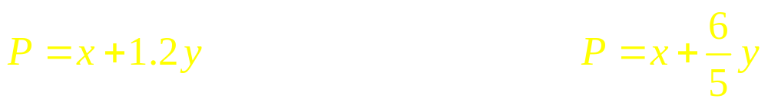



Applied Example 1: A Production Problem
Recall the production problem discussed in section 6.3, which required us to maximize the objective function
subject to the system of inequalities
This is a standard maximization problem and may be solved by the simplex method.
Set up the initial simplex tableau for this linear programming problem.

Slide 7
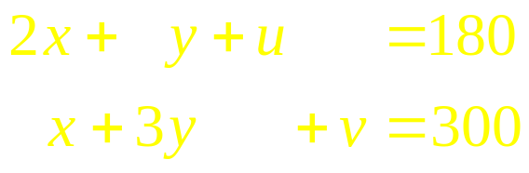
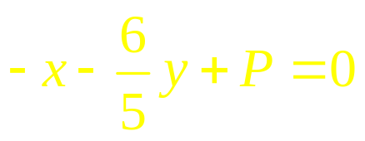
Applied Example 1: A Production Problem
Solution
First, introduce the slack variables u and v into the inequalities
and turn these into equations, getting
Next, rewrite the objective function in the form

Slide 8
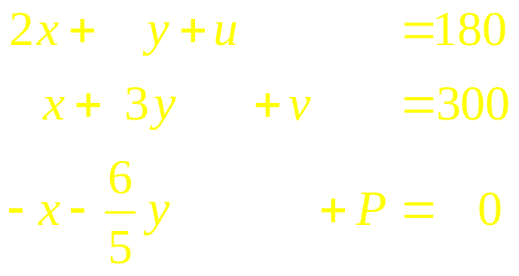
Applied Example 1: A Production Problem
Solution
Placing the restated objective function below the system of equations of the constraints we get
Thus, the initial tableau associated with this system is
x | y | u | v | P | Constant
2 | 1 | 1 | 0 | 0 | 180
1 | 3 | 0 | 1 | 0 | 300
–1 | – 6/5 | 0 | 0 | 1 | 0

Slide 9
The Simplex Method
Set up the initial simplex tableau.
Determine whether the optimal solution has been reached by examining all entries in the last row to the left of the vertical line.
  If all the entries are nonnegative, the optimal solution has been reached. Proceed to step 4.
  If there are one or more negative entries, the optimal solution has not been reached. Proceed to step 3.
Perform the pivot operation. Return to step 2.
Determine the optimal solution(s).

Slide 10
Applied Example 1: A Production Problem
Recall again the production problem discussed previously.
We have already performed step 1 obtaining the initial simplex tableau:
Now, complete the solution to the problem.
x | y | u | v | P | Constant
2 | 1 | 1 | 0 | 0 | 180
1 | 3 | 0 | 1 | 0 | 300
–1 | – 6/5 | 0 | 0 | 1 | 0

Slide 11
Applied Example 1: A Production Problem
Solution
Step 2. Determine whether the optimal solution has been reached.
  Since there are negative entries in the last row of the tableau, the initial solution is not optimal.
x | y | u | v | P | Constant
2 | 1 | 1 | 0 | 0 | 180
1 | 3 | 0 | 1 | 0 | 300
–1 | – 6/5 | 0 | 0 | 1 | 0

Slide 12
Applied Example 1: A Production Problem
Solution
Step 3. Perform the pivot operation.
  Since the entry – 6/5 is the most negative entry to the left of the vertical line in the last row of the tableau, the second column in the tableau is the pivot column.
x | y | u | v | P | Constant
2 | 1 | 1 | 0 | 0 | 180
1 | 3 | 0 | 1 | 0 | 300
–1 | – 6/5 | 0 | 0 | 1 | 0

Slide 13
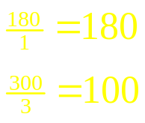
Applied Example 1: A Production Problem
Solution
Step 3. Perform the pivot operation.
  Divide each positive number of the pivot column into the corresponding entry in the column of constants and compare the ratios thus obtained.
  We see that the ratio 300/3 = 100 is less than the ratio 180/1 = 180, so row 2 is the pivot row.
x | y | u | v | P | Constant
2 | 1 | 1 | 0 | 0 | 180
1 | 3 | 0 | 1 | 0 | 300
–1 | – 6/5 | 0 | 0 | 1 | 0

Slide 14
Applied Example 1: A Production Problem
Solution
Step 3. Perform the pivot operation.
  The entry 3 lying in the pivot column and the pivot row is the pivot element.
x | y | u | v | P | Constant
2 | 1 | 1 | 0 | 0 | 180
1 | 3 | 0 | 1 | 0 | 300
–1 | – 6/5 | 0 | 0 | 1 | 0

Slide 15

Applied Example 1: A Production Problem
Solution
Step 3. Perform the pivot operation.
  Convert the pivot element into a 1.
x | y | u | v | P | Constant
2 | 1 | 1 | 0 | 0 | 180
1 | 3 | 0 | 1 | 0 | 300
–1 | – 6/5 | 0 | 0 | 1 | 0

Slide 16
Applied Example 1: A Production Problem
Solution
Step 3. Perform the pivot operation.
  Convert the pivot element into a 1.
x | y | u | v | P | Constant
2 | 1 | 1 | 0 | 0 | 180
1/3 | 1 | 0 | 1/3 | 0 | 100
–1 | – 6/5 | 0 | 0 | 1 | 0

Slide 17
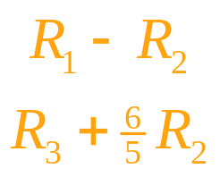
Applied Example 1: A Production Problem
Solution
Step 3. Perform the pivot operation.
  Use elementary row operations to convert the pivot column into a unit column.
x | y | u | v | P | Constant
2 | 1 | 1 | 0 | 0 | 180
1/3 | 1 | 0 | 1/3 | 0 | 100
–1 | – 6/5 | 0 | 0 | 1 | 0

Slide 18
Applied Example 1: A Production Problem
Solution
Step 3. Perform the pivot operation.
  Use elementary row operations to convert the pivot column into a unit column.
x | y | u | v | P | Constant
5/3 | 0 | 1 | –1/3 | 0 | 80
1/3 | 1 | 0 | 1/3 | 0 | 100
–3/5 | 0 | 0 | 2/5 | 1 | 120

Slide 19
Applied Example 1: A Production Problem
Solution
Step 3. Perform the pivot operation.
  This completes an iteration.
  The last row of the tableau contains a negative number, so an optimal solution has not been reached.
  Therefore, we repeat the iteration step.
x | y | u | v | P | Constant
5/3 | 0 | 1 | –1/3 | 0 | 80
1/3 | 1 | 0 | 1/3 | 0 | 100
–3/5 | 0 | 0 | 2/5 | 1 | 120

Slide 20
Applied Example 1: A Production Problem
Solution
Step 3. Perform the pivot operation again.
  Since the entry – 3/5 is the most negative entry to the left of the vertical line in the last row of the tableau, the first column in the tableau is now the pivot column.
x | y | u | v | P | Constant
5/3 | 0 | 1 | –1/3 | 0 | 80
1/3 | 1 | 0 | 1/3 | 0 | 100
–3/5 | 0 | 0 | 2/5 | 1 | 120

Slide 21
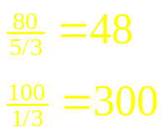
Applied Example 1: A Production Problem
Solution
Step 3. Perform the pivot operation.
  Divide each positive number of the pivot column into the corresponding entry in the column of constants and compare the ratios thus obtained.
  We see that the ratio 80/(5/3) = 48 is less than the ratio 100/(1/3) = 300, so row 1 is the pivot row now.
x | y | u | v | P | Constant
5/3 | 0 | 1 | –1/3 | 0 | 80
1/3 | 1 | 0 | 1/3 | 0 | 100
–3/5 | 0 | 0 | 2/5 | 1 | 120
Ratio

Slide 22
Applied Example 1: A Production Problem
Solution
Step 3. Perform the pivot operation.
  The entry 5/3 lying in the pivot column and the pivot row is the pivot element.
x | y | u | v | P | Constant
5/3 | 0 | 1 | –1/3 | 0 | 80
1/3 | 1 | 0 | 1/3 | 0 | 100
–3/5 | 0 | 0 | 2/5 | 1 | 120

Slide 23

Applied Example 1: A Production Problem
Solution
Step 3. Perform the pivot operation.
  Convert the pivot element into a 1.
x | y | u | v | P | Constant
5/3 | 0 | 1 | –1/3 | 0 | 80
1/3 | 1 | 0 | 1/3 | 0 | 100
–3/5 | 0 | 0 | 2/5 | 1 | 120

Slide 24
Applied Example 1: A Production Problem
Solution
Step 3. Perform the pivot operation.
  Convert the pivot element into a 1.
x | y | u | v | P | Constant
1 | 0 | 3/5 | –1/5 | 0 | 48
1/3 | 1 | 0 | 1/3 | 0 | 100
–3/5 | 0 | 0 | 2/5 | 1 | 120

Slide 25
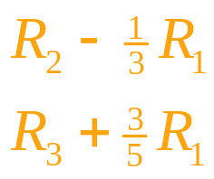
Applied Example 1: A Production Problem
Solution
Step 3. Perform the pivot operation.
  Use elementary row operations to convert the pivot column into a unit column.
x | y | u | v | P | Constant
1 | 0 | 3/5 | –1/5 | 0 | 48
1/3 | 1 | 0 | 1/3 | 0 | 100
–3/5 | 0 | 0 | 2/5 | 1 | 120

Slide 26
Applied Example 1: A Production Problem
Solution
Step 3. Perform the pivot operation.
  Use elementary row operations to convert the pivot column into a unit column.
x | y | u | v | P | Constant
1 | 0 | 3/5 | –1/5 | 0 | 48
0 | 1 | –1/5 | 2/5 | 0 | 84
0 | 0 | 9/25 | 7/25 | 1 | 148 4/5

Slide 27
Applied Example 1: A Production Problem
Solution
Step 3. Perform the pivot operation.
  The last row of the tableau contains no negative numbers, so an optimal solution has been reached.
x | y | u | v | P | Constant
1 | 0 | 3/5 | –1/5 | 0 | 48
0 | 1 | –1/5 | 2/5 | 0 | 84
0 | 0 | 9/25 | 7/25 | 1 | 148 4/5

Slide 28
Applied Example 1: A Production Problem
Solution
Step 4. Determine the optimal solution.
  Locate the basic variables in the final tableau.
  In this case, the basic variables are x, y, and P.
    The optimal value for x is 48.
    The optimal value for y is 84.
    The optimal value for P is 148.8.
  Thus, the firm will maximize profits at $148.80 by producing 48 type-A souvenirs and 84 type-B souvenirs.
  This agrees with the results obtained in section 6.3.
x | y | u | v | P | Constant
1 | 0 | 3/5 | –1/5 | 0 | 48
0 | 1 | –1/5 | 2/5 | 0 | 84
0 | 0 | 9/25 | 7/25 | 1 | 148 4/5

Slide 29
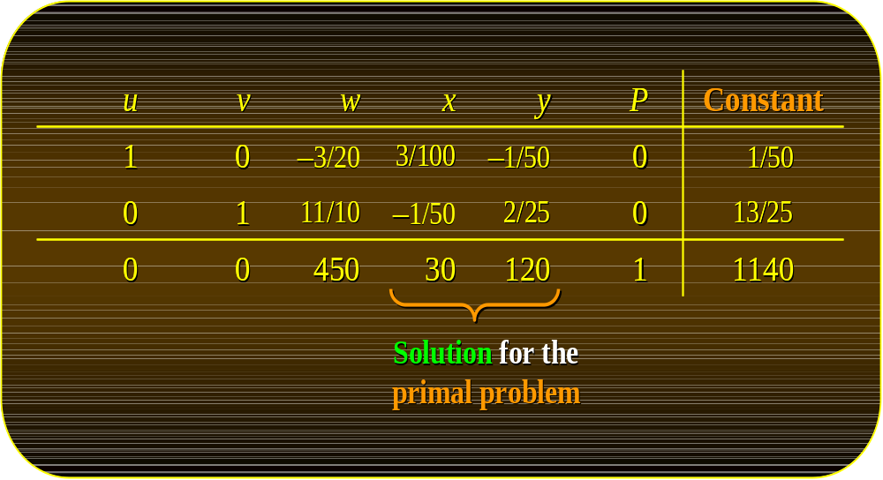
The Simplex Method:
Standard Minimization Problems

Slide 30
Minimization with ≤ Constraints
In the last section we developed the simplex method to solve linear programming problems that satisfy three conditions:
  The objective function is to be maximized.
  All the variables involved are nonnegative.
  Each linear constraint may be written so that the expression involving the variables is less than or equal to a nonnegative constant.
We will now see how the simplex method can be used to solve minimization problems that meet the second and third conditions listed above.

Slide 31

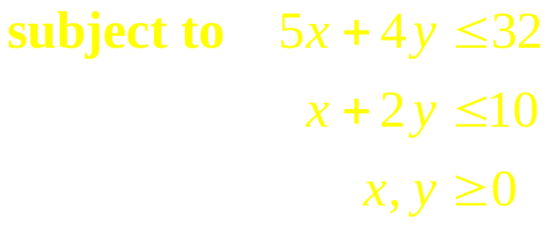
Example
Solve the following linear programming problem:
This problem involves the minimization of the objective function and so is not a standard maximization problem.
Note, however, that all the other conditions for a standard maximization hold true.

Slide 32

Example
We can use the simplex method to solve this problem by converting the objective function from minimizing C to its equivalent of maximizing P = – C.
Thus, the restated linear programming problem is
This problem can now be solved using the simplex method as discussed in section 6.4.

Slide 33
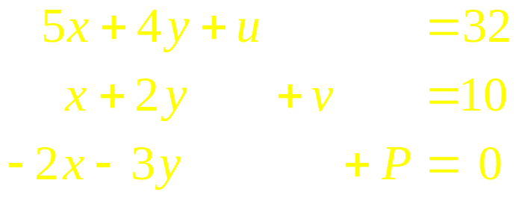
Example
Solution
Step 1. Set up the initial simplex tableau.
  Turn the constraints into equations adding to them the slack variables u and v. Also rearrange the objective function and place it below the constraints:
  Write the coefficients of the system in a tableau:
x | y | u | v | P |  | Constant
5 | 4 | 1 | 0 | 0 |  | 32
1 | 2 | 0 | 1 | 0 |  | 10
–2 | –3 | 0 | 0 | 1 |  | 0

Slide 34
Example
Solution
Step 2. Determine whether the optimal solution has been reached.
  Since there are negative entries in the last row of the tableau, the initial solution is not optimal.
x | y | u | v | P |  | Constant
5 | 4 | 1 | 0 | 0 |  | 32
1 | 2 | 0 | 1 | 0 |  | 10
–2 | –3 | 0 | 0 | 1 |  | 0

Slide 35
Example
Solution
Step 3. Perform the pivot operation.
  Since the entry – 3 is the most negative entry to the left of the vertical line in the last row of the tableau, the second column in the tableau is the pivot column.
x | y | u | v | P |  | Constant
5 | 4 | 1 | 0 | 0 |  | 32
1 | 2 | 0 | 1 | 0 |  | 10
–2 | –3 | 0 | 0 | 1 |  | 0

Slide 36
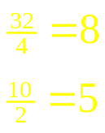
Example
Solution
Step 3. Perform the pivot operation.
  Divide each positive number of the pivot column into the corresponding entry in the column of constants and compare the ratios thus obtained.
  We see that the ratio 10/2 = 5 is less than the ratio 32/4 = 8, so row 2 is the pivot row.
x | y | u | v | P |  | Constant
5 | 4 | 1 | 0 | 0 |  | 32
1 | 2 | 0 | 1 | 0 |  | 10
–2 | –3 | 0 | 0 | 1 |  | 0
Ratio

Slide 37
Example
Solution
Step 3. Perform the pivot operation.
  The entry 2 lying in the pivot column and the pivot row is the pivot element.
x | y | u | v | P |  | Constant
5 | 4 | 1 | 0 | 0 |  | 32
1 | 2 | 0 | 1 | 0 |  | 10
–2 | –3 | 0 | 0 | 1 |  | 0

Slide 38

Example
Solution
Step 3. Perform the pivot operation.
  Convert the pivot element into a 1.
x | y | u | v | P |  | Constant
5 | 4 | 1 | 0 | 0 |  | 32
1 | 2 | 0 | 1 | 0 |  | 10
–2 | –3 | 0 | 0 | 1 |  | 0

Slide 39
Example
Solution
Step 3. Perform the pivot operation.
  Convert the pivot element into a 1.
x | y | u | v | P |  | Constant
5 | 4 | 1 | 0 | 0 |  | 32
1/2 | 1 | 0 | 1/2 | 0 |  | 5
–2 | –3 | 0 | 0 | 1 |  | 0

Slide 40
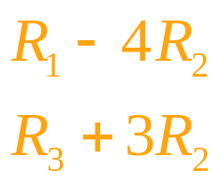
Example
Solution
Step 3. Perform the pivot operation.
  Use elementary row operations to convert the pivot column into a unit column.
x | y | u | v | P |  | Constant
5 | 4 | 1 | 0 | 0 |  | 32
1/2 | 1 | 0 | 1/2 | 0 |  | 5
–2 | –3 | 0 | 0 | 1 |  | 0

Slide 41
Example
Solution
Step 3. Perform the pivot operation.
  Use elementary row operations to convert the pivot column into a unit column.
x | y | u | v | P |  | Constant
3 | 0 | 1 | –2 | 0 |  | 12
1/2 | 1 | 0 | 1/2 | 0 |  | 5
–1/2 | 0 | 0 | 3/2 | 1 |  | 15

Slide 42
Example
Solution
Step 3. Perform the pivot operation.
  This completes an iteration.
  The last row of the tableau contains a negative number, so an optimal solution has not been reached.
  Therefore, we repeat the iteration step.
x | y | u | v | P |  | Constant
3 | 0 | 1 | –2 | 0 |  | 12
1/2 | 1 | 0 | 1/2 | 0 |  | 5
–1/2 | 0 | 0 | 3/2 | 1 |  | 15

Slide 43
Example
Solution
Step 3. Perform the pivot operation.
  Since the entry –1/2 is the most negative entry to the left of the vertical line in the last row of the tableau, the first column in the tableau is now the pivot column.
x | y | u | v | P |  | Constant
3 | 0 | 1 | –2 | 0 |  | 12
1/2 | 1 | 0 | 1/2 | 0 |  | 5
–1/2 | 0 | 0 | 3/2 | 1 |  | 15

Slide 44
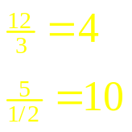
Example
Solution
Step 3. Perform the pivot operation.
  Divide each positive number of the pivot column into the corresponding entry in the column of constants and compare the ratios thus obtained.
  We see that the ratio 12/3 = 4 is less than the ratio 5/(1/2) = 10, so row 1 is now the pivot row.
x | y | u | v | P |  | Constant
3 | 0 | 1 | –2 | 0 |  | 12
1/2 | 1 | 0 | 1/2 | 0 |  | 5
–1/2 | 0 | 0 | 3/2 | 1 |  | 15

Slide 45
Example
Solution
Step 3. Perform the pivot operation.
  The entry 3 lying in the pivot column and the pivot row is the pivot element.
x | y | u | v | P |  | Constant
3 | 0 | 1 | –2 | 0 |  | 12
1/2 | 1 | 0 | 1/2 | 0 |  | 5
–1/2 | 0 | 0 | 3/2 | 1 |  | 15

Slide 46

Example
Solution
Step 3. Perform the pivot operation.
  Convert the pivot element into a 1.
x | y | u | v | P |  | Constant
3 | 0 | 1 | –2 | 0 |  | 12
1/2 | 1 | 0 | 1/2 | 0 |  | 5
–1/2 | 0 | 0 | 3/2 | 1 |  | 15

Slide 47
Example
Solution
Step 3. Perform the pivot operation.
  Convert the pivot element into a 1.
x | y | u | v | P |  | Constant
1 | 0 | 1/3 | –2/3 | 0 |  | 4
1/2 | 1 | 0 | 1/2 | 0 |  | 5
–1/2 | 0 | 0 | 3/2 | 1 |  | 15

Slide 48
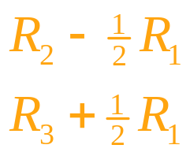
Example
Solution
Step 3. Perform the pivot operation.
  Use elementary row operations to convert the pivot column into a unit column.
x | y | u | v | P |  | Constant
1 | 0 | 1/3 | –2/3 | 0 |  | 4
1/2 | 1 | 0 | 1/2 | 0 |  | 5
–1/2 | 0 | 0 | 3/2 | 1 |  | 15

Slide 49
Example
Solution
Step 3. Perform the pivot operation.
  Use elementary row operations to convert the pivot column into a unit column.
x | y | u | v | P |  | Constant
1 | 0 | 1/3 | –2/3 | 0 |  | 4
0 | 1 | –1/6 | 5/6 | 0 |  | 3
0 | 0 | 1/6 | 7/6 | 1 |  | 17

Slide 50
Example
Solution
Step 3. Perform the pivot operation.
  The last row of the tableau contains no negative numbers, so an optimal solution has been reached.
x | y | u | v | P |  | Constant
1 | 0 | 1/3 | –2/3 | 0 |  | 4
0 | 1 | –1/6 | 5/6 | 0 |  | 3
0 | 0 | 1/6 | 7/6 | 1 |  | 17

Slide 51
Example
Solution
Step 4. Determine the optimal solution.
  Locate the basic variables in the final tableau.
  In this case, the basic variables are x, y, and P.
    The optimal value for x is 4.
    The optimal value for y is 3.
    The optimal value for P is 17, which means that the minimized value for C is –17.
x | y | u | v | P |  | Constant
1 | 0 | 1/3 | –2/3 | 0 |  | 4
0 | 1 | –1/6 | 5/6 | 0 |  | 3
0 | 0 | 1/6 | 7/6 | 1 |  | 17

Slide 52
The Dual Problem
Another special class of linear programming problems we encounter in practical applications is characterized by the following conditions:
  The objective function is to be minimized.
  All the variables involved are nonnegative.
  All other linear constraints may be written so that the expression involving the variables is greater than or equal to a nonnegative constant.
Such problems are called standard minimization problems.

Slide 53
The Dual Problem
In solving this kind of linear programming problem, it helps to note that each maximization problem is associated with a minimization problem, and vice versa.
The given problem is called the primal problem, and the related problem is called the dual problem.

Slide 54

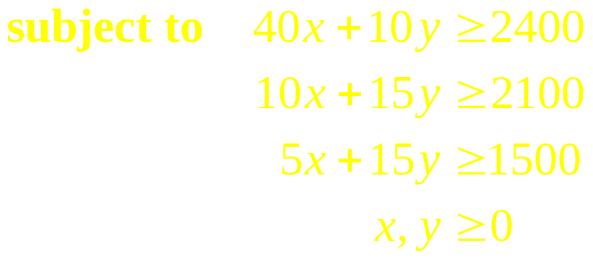
Example
Write the dual problem associated with this problem:
We first write down a tableau for the primal problem:
Primal Problem
x | y |  | Constant
40 | 10 |  | 2400
10 | 15 |  | 2100
5 | 15 |  | 1500
6 | 8

Slide 55
Example
x | y |  | Constant
40 | 10 |  | 2400
10 | 15 |  | 2100
5 | 15 |  | 1500
6 | 8
Next, we interchange the columns and rows of the tableau and head the three columns of the resulting array with the three variables u, v, and w, obtaining
u | v | w |  | Constant
40 | 10 | 5 |  | 6
10 | 15 | 15 |  | 8
2400 | 2100 | 1500

Slide 56
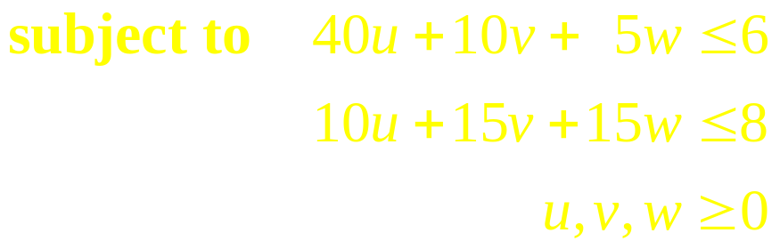
Example
u | v | w |  | Constant
40 | 10 | 5 |  | 6
10 | 15 | 15 |  | 8
2400 | 2100 | 1500
Consider the resulting tableau as if it were the initial simplex tableau for a standard maximization problem.
From it we can reconstruct the required dual problem:
Dual Problem

Slide 57
Theorem 1
The Fundamental Theorem of Duality
A primal problem has a solution if and only if the corresponding dual problem has a solution.
Furthermore, if a solution exists, then:
  The objective functions of both the primal and the dual problem attain the same optimal value.
  The optimal solution to the primal problem appears under the slack variables in the last row of the final simplex tableau associated with the dual problem.

Slide 58
Example
Complete the solution of the problem from our last example:
Dual Problem

Slide 59
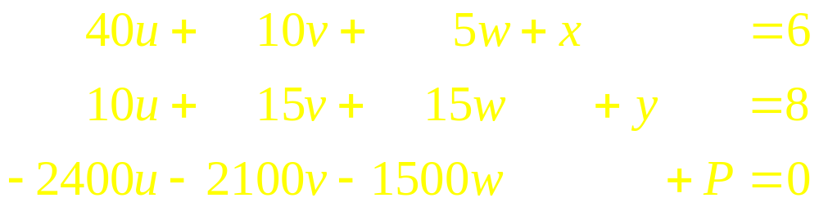
Example
Solution
The dual problem associated with the given primal problem is a standard maximization problem.
Thus, we can proceed with the simplex method.
First, we introduce to the system of equations the slack variables x and y, and restate the inequalities as equations, obtaining

Slide 60
Example
Solution
Next, we transcribe the coefficients of the system of equations
into an initial simplex tableau:
u | v | w | x | y | P |  | Constant
40 | 10 | 5 | 1 | 0 | 0 |  | 6
10 | 15 | 15 | 0 | 1 | 0 |  | 8
–2400 | –2100 | –1500 | 0 | 0 | 1 |  | 0

Slide 61
Example
Solution
Continue with the simplex iterative method until a final tableau is obtained with the solution for the problem:
The fundamental theorem of duality tells us that the solution to the primal problem is x = 30 and y = 120, with a minimum value for C of 1140.
u | v | w | x | y | P |  | Constant
1 | 0 | –3/20 | 3/100 | –1/50 | 0 |  | 1/50
0 | 1 | 11/10 | –1/50 | 2/25 | 0 |  | 13/25
0 | 0 | 450 | 30 | 120 | 1 |  | 1140
Solution for the primal problem

